Slide 1

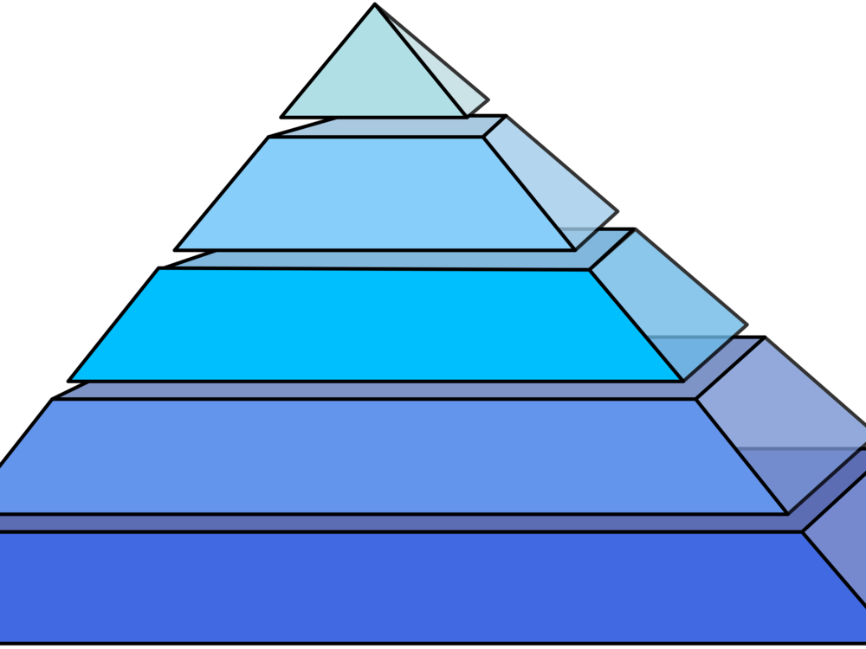




Southend School Sports Partnership
Secondary Virtual Challenges
Half term pyramid workout
10 seconds mountain climbers
20 seconds Push Ups
30 seconds Squats
40 seconds Tricep dips
50 seconds jumping jacks
60 seconds Plank hold
50 seconds jumping jacks
40 seconds Tricep dips
30 seconds squat jumps
20 seconds press ups
10 seconds mountain climbers
Have a go at the pyramid circuit where the time per exercise gets longer each time to the peak of the pyramid and then reduces on the way back down!
Add a 10 second rest break between each exercise if required.
#SouthendSGOChallenge

