Slide 1


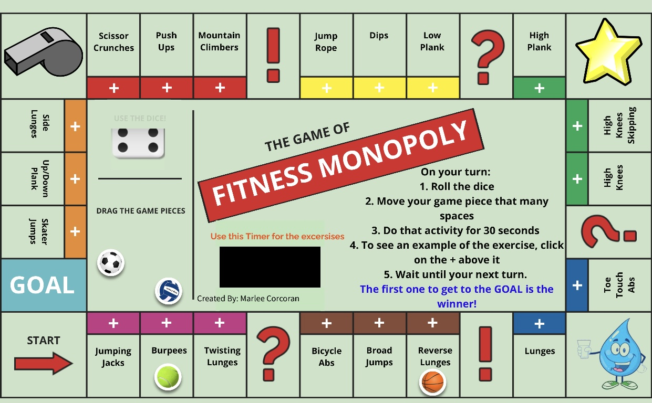



Southend School Sports Partnership
Secondary Virtual Challenges
Week 3 SGO Secondary Challenge:
When: Monday 25th- Sunday 31st January
Fitness Monopoly
Play this interactive
game with a sibling/
parent or via zoom
with a friend for a great
workout!
Click the link
Fitness Monopoly by marlee.corcoran on Genially

