Slide 1

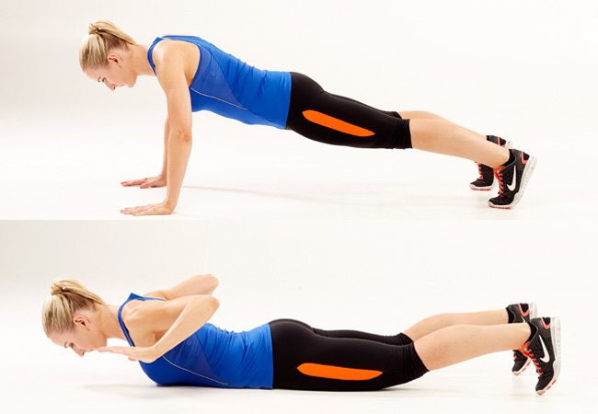


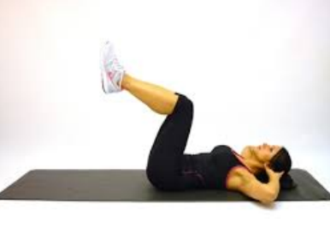

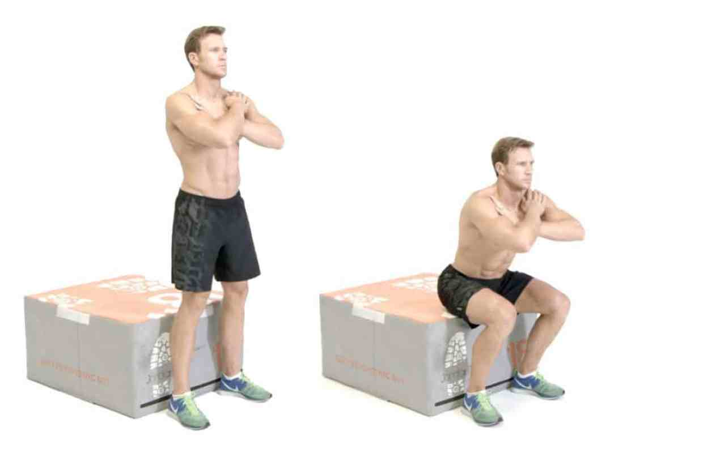

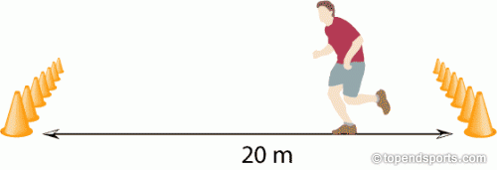
Southend School Sports Partnership
Virtual Challenges
Week 6 SGO Secondary Challenges:
Challenge: Crossfit challenge
The Challenge will consist of 4 events
Push ups
Sit Ups
Squats
20 metre shuttle runs
Participants will complete as many reps as possible in a minute in each event.
Details of the events are on the next page.
#SGOChallenge

Slide 2
Southend School Sports Partnership
Virtual Challenges
Push ups: Hand release push ups. Start in press up position with arms locked out, when timer starts lower themselves to the ground until their chest touches the floor. Push back up until arms are locked out
= 1 rep.
Sit Ups: Start on your back with legs raised and knees bent at a 90 degree angle. Cross arms and place hands on the shoulders, on the timer bring elbows up until they touch their knees, whilst keeping hand on their shoulders, lower yourself back down until their upper back touches the floor = 1 rep.
Squats: Start by standing in front of a bench/seat. On the timer start to squat backwards and down driving the knees out. Keeping core braced, torso upright and their heels in contact with the floor. When bottom touches the bench drive through heels and push back to standing = 1 rep.
20 metre shuttle runs: Measure out 20m on the timer participants spring from one line to the other, one of their feet must touch the line = 1 rep.

