Slide 1

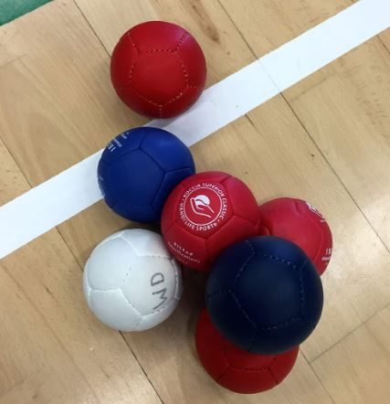



certificate
This certificate is proudly presented to:
for competing in the SPSSA Boccia competition
at Garons.
Wednesday 29th November 2023
Signed

